Slide 1


What Makes A Playlist Successful?
By Venkat Aganya Mutupuri
Notes:
Hi everyone, Thanks for taking some time out and joining. We’ll be going over the analysis of what makes a playlist successful based on the dataset presented to me.

Slide 2
Agenda
Part A:
Problem Statement And Dataset
Summary Statistics
Defining Success And Metrics To Measure Success
Exploring Successful And Unsuccessful Playlists
Summary
Part B:
How would you change the current schema, or design a new one, to make it more analysis friendly?
If this data was scaled up 1000x, across multiple tables, how would you have differently designed your solution and why? What about if the data was scaled up 1000000x?
If you were asked to produce a version of your work which ran in an automated way, how would you do so?
Notes:
For today's agenda: I have divided the presentation into two parts
Part A: is the Analysis of the data set and summarizing the analysis
Part B: are the questions asked in terms of Schema, Scale and Automation

Slide 3
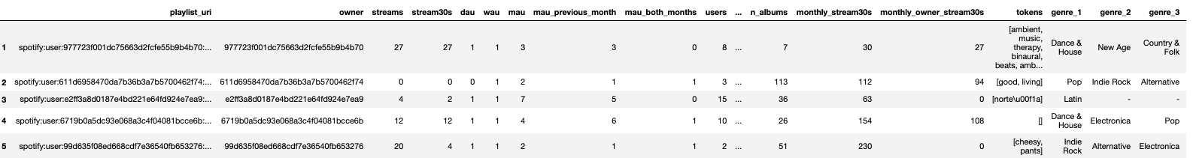
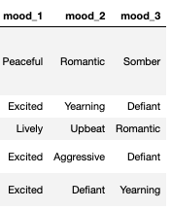
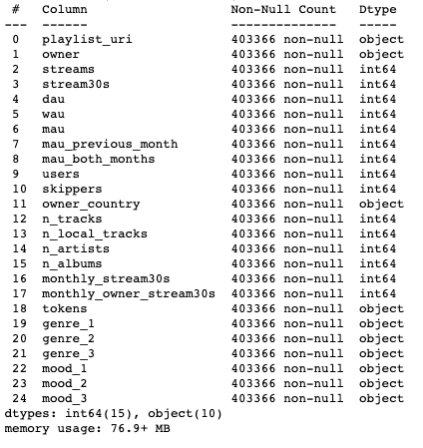
Problem Statement: What Makes A Playlist Successful?
Dataset
The dataset contains 403366 observations and 25 variables
Data types are integer for numeric variables and string for
text variables
Notes:
I have used Python and Pandas for the entire analysis
Once I have extracted the data from the file, We can see there are about 403,336 rows and about 25 different variables
We do not have a wide variety of data types; we just have string and int which should be fine looking at the memory it is using and did not see a reason to optimize or change the datatypes.

Slide 4

Summary Statistics
Notes:
Summary statistics, Here we will be exploring the data set to get a good understanding of how the data is available to us.

Slide 5
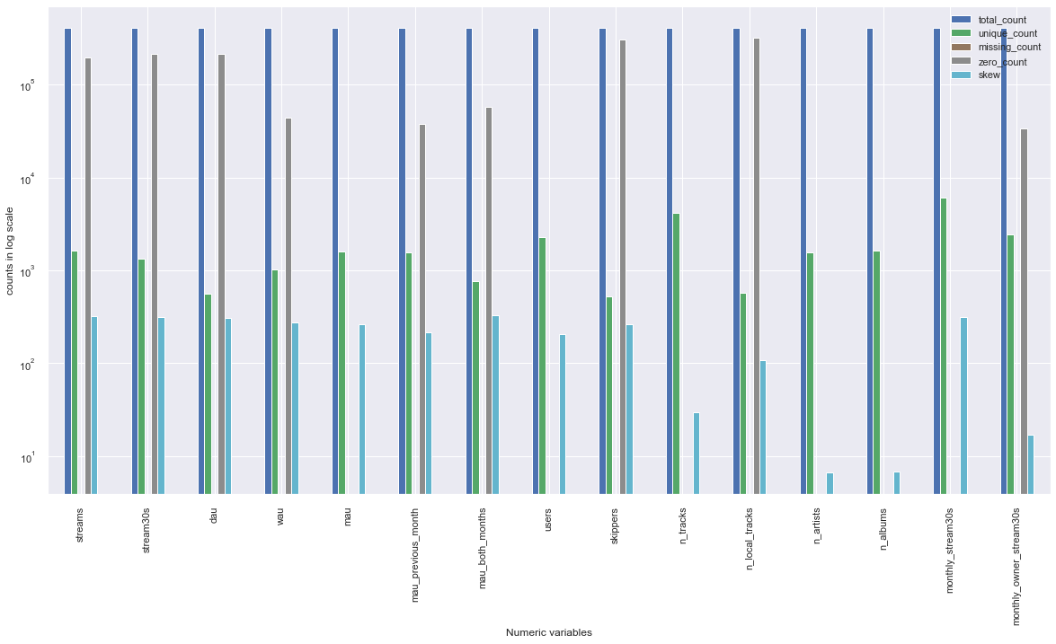
Summary Statistics: Numeric Variables
Zero count is on the higher side for variables like streams, dau, skippers, n_local_tracks.
Notes:
As we know we have 25 variables and 2 types one is string and the other int, I wanted to get a good understanding of them individually
Here we are looking at numeric variables
This graph shows us the counts for num variables
From the graph we can see that, first, we do not have any missing values in our numeric variables
We do have zero counts in almost all our numeric variables
But for variables like streams, stream30s, dau the 0 count is on the higher side compared to others.

Slide 6

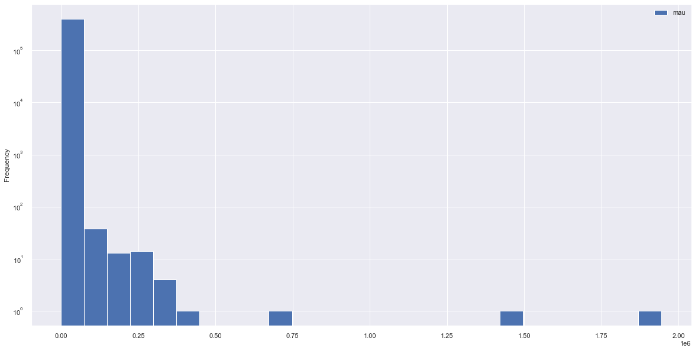

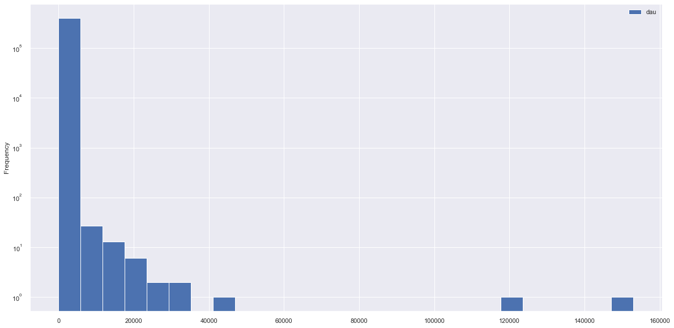
Summary Statistics: Data Distribution
mau
dau
Notes:
Here we look at distribution of couple of numeric variables, we see that we have a lot of data at the lower boundary

Slide 7
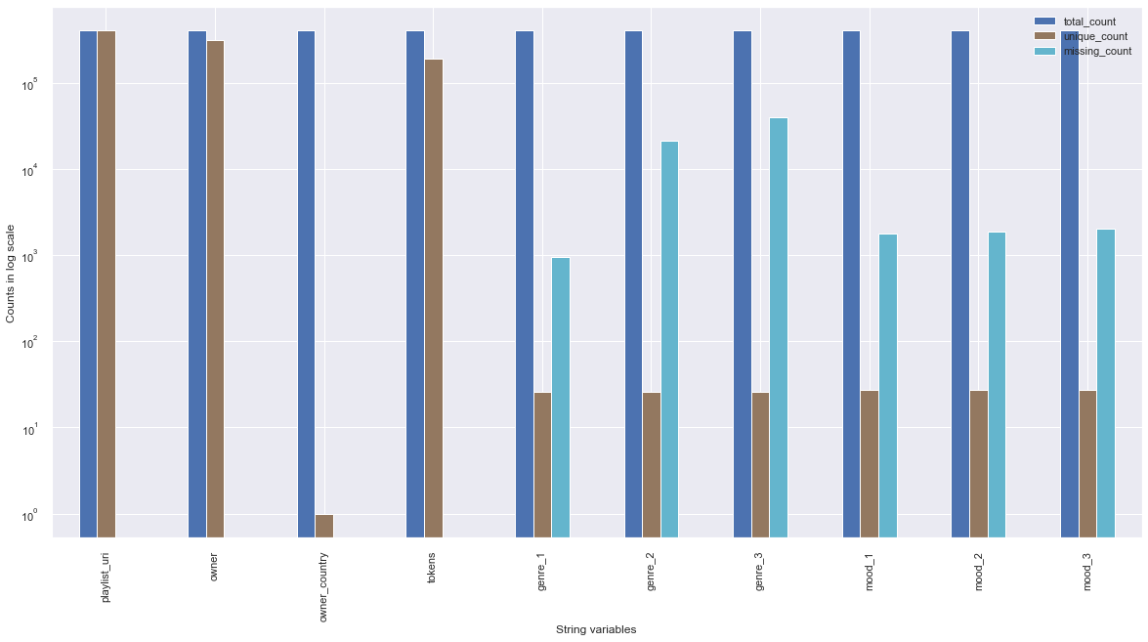
Summary Statistics: String Variables
Missing values indicated with ‘-’ are on the higher side for variables like genre and mood compared to owner, country which do not have any missing values.
Notes:
The other set of variables present in the data set are string variables
For these set of variables, we are only looking at total counts, unique counts and missing counts
One observation I would want to state is that: For the string variables, I have noticed missing values are indicated with a hyphen, so in our code we have included this to be considered as a missing value along with empty strings, nulls and other type of missing values.
From the graph we can see that we do have some missing values in genres and moods.

Slide 8
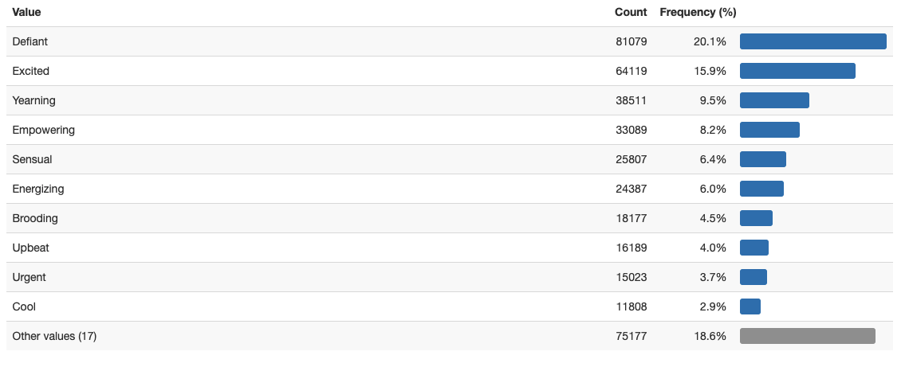
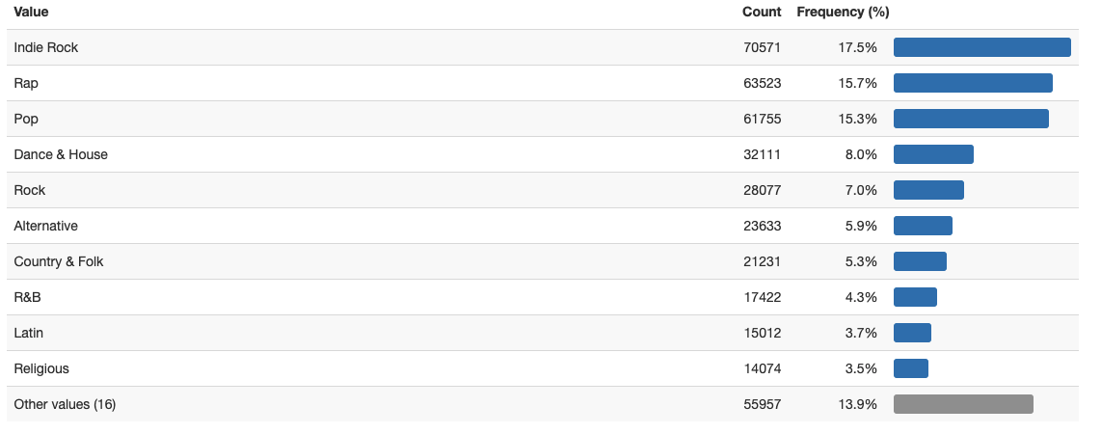
Summary Statistics: Frequency Charts
Genre
Mood
Notes:
Looking at a couple of string variables and their frequency charts, for our genre and mood variables specifically g-1 and m_1

Slide 9
Observations From The Data
Number of variables: 25, string variables: 10, numeric variables: 15
Data is skewed to the right
No duplicates in the dataset
Variables like streams, sream30s, dau, skippers, n_local_tracks have 0 count > 50% of the total count
Variable owner_country has 1 unique value
String variables have < 10% missing values
Datatypes are optimized, we can convert genre and moods to categories as there are approximately 27 unique values out of 403366 values in the data set
Notes:
* So this is the data and how we structured to get a good understanding of the data
* these summaries provide us a good insight into how we can use this data or if we need to do any cleansing on the data

Slide 10

Defining Success
Notes:
We are going to take a look at defining success and metrics we are going use for limiting the data that we for our analysis and will use these metrics to indicate as successful and unsuccessful.
And we are going to look into see how different variables have an over all impact on what we indicated as successful playlists.

Slide 11
Defining Success And Metrics To Measure Success
Success from a product perspective is to have high active users on the platform and engage users for longer stream time.
Metrics like dau, mau, streams30s, ma_streams30s will give us insight into active user streams over 30 seconds on the platform and give us insight into engagement with the playlists.
Notes:
Success is arbitrary and success depends on perspective.
From a product standpoint, ideally, we would want to have high active users using our product and users are engaged with the product for a longer time.
We can define success in many ways and by looking at different metrics.
So, from my view/definition for the scope of the project is by using metrics like daily active, mau, dstreams, mstreamas to identify successful playlists.

Slide 12
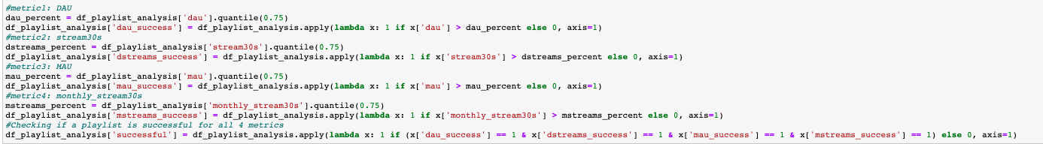
Classifying Playlists As Successful And Unsuccessful
Success for each metric: for each metric selected, data in the ¼ top quarter or top 25% is considered as successful, bottom ¾ quarter or bottom 75% is considered unsuccessful for the specific metric.
Defining a successful playlist: once we indicate success for each metric if the playlist is successful on all chosen metrics, the playlist is tagged as overall successful.
There are ~5% successful playlists of total playlists for all the chosen metrics.
Notes:
This is a 2 step process
The first step being
For each metric we choose, we are indicating, data that is in the top quarter or top 25% is being considered as successful playlist for the specific metric.
We do this by checking data for the metric at 75th percentile and anything greater than that is successful observation for that metric
We do the same process for all the metric we chose
For the second step
Once we have indicators available for all 4 metrics, we have logic in place to check if a playlist is indicated successful for all 4 metrics, we chose
Then we indicate the whole playlist as successful
By doing this we are narrowing the scope for the analysis and realistically we do not want to call 50% of the data to be successful
Ideally, we get about 5% of the playlists to be successful
Next is we explore the factors that have an impact on these two different type of playlists

Slide 13
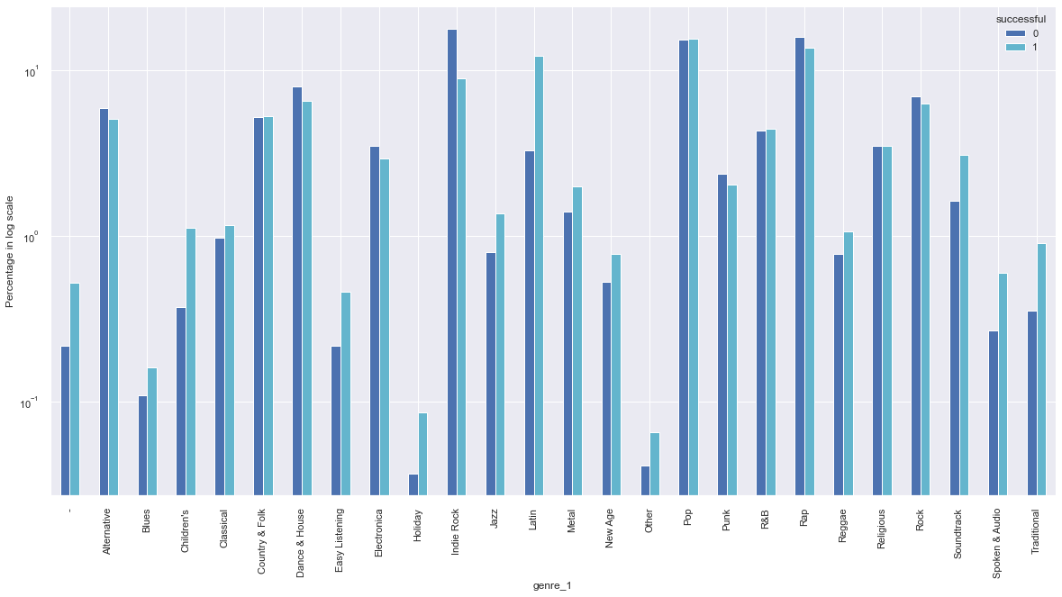
Genres For Successful And Unsuccessful Playlists
genre 1: highest weighted genre
Notes:
We can see that from the highest weighted genre by songs that we have some genres that are popular in successful playlists
Also we see the popular genres in unsuccessful playlists

Slide 14
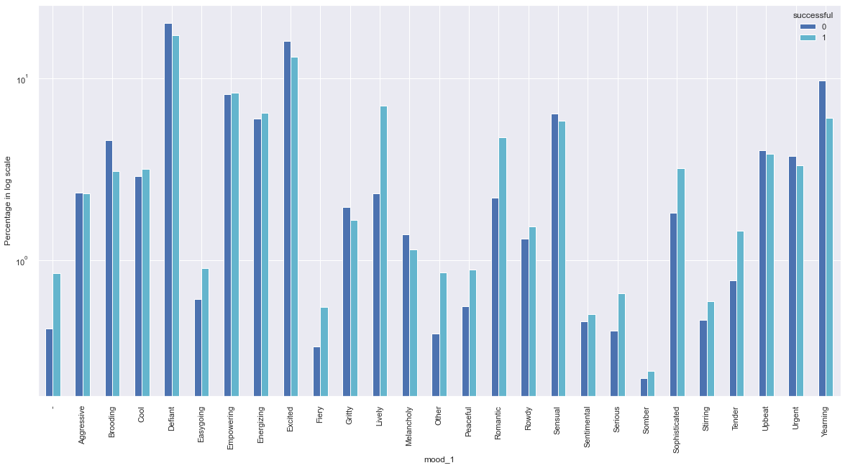
Moods For Successful And Unsuccessful Playlists
mood 1: highest weighted mood
Notes:
Similar case for moods as well, we have moods that are popular among successful playlists vs un successful playlists

Slide 15
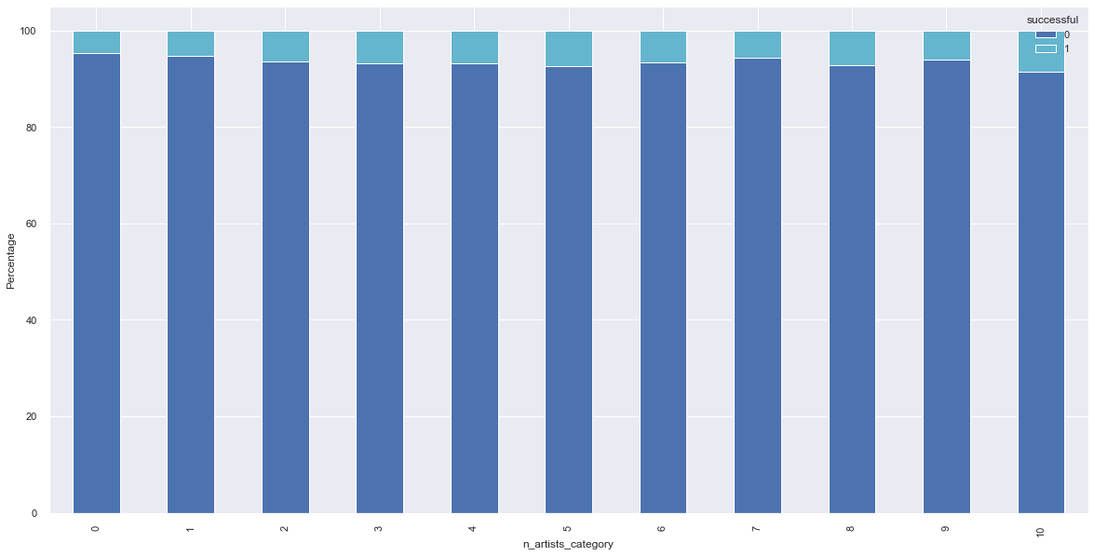
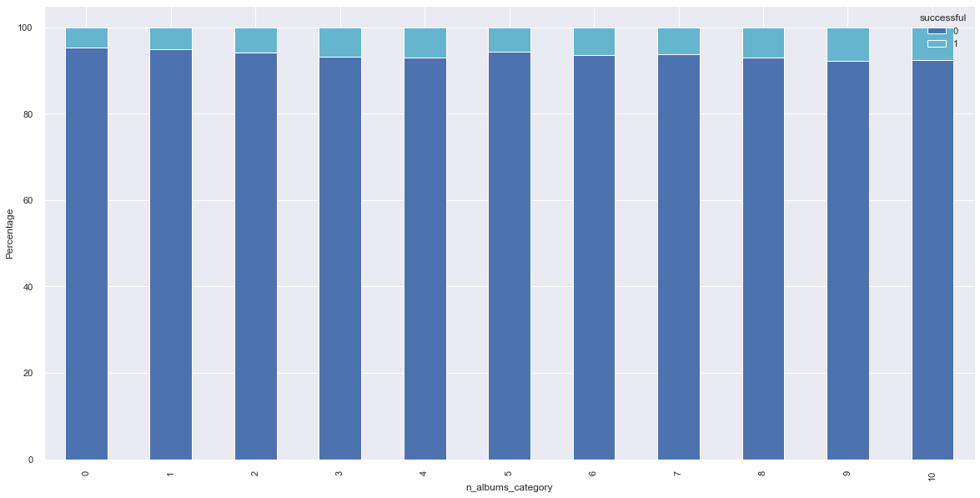
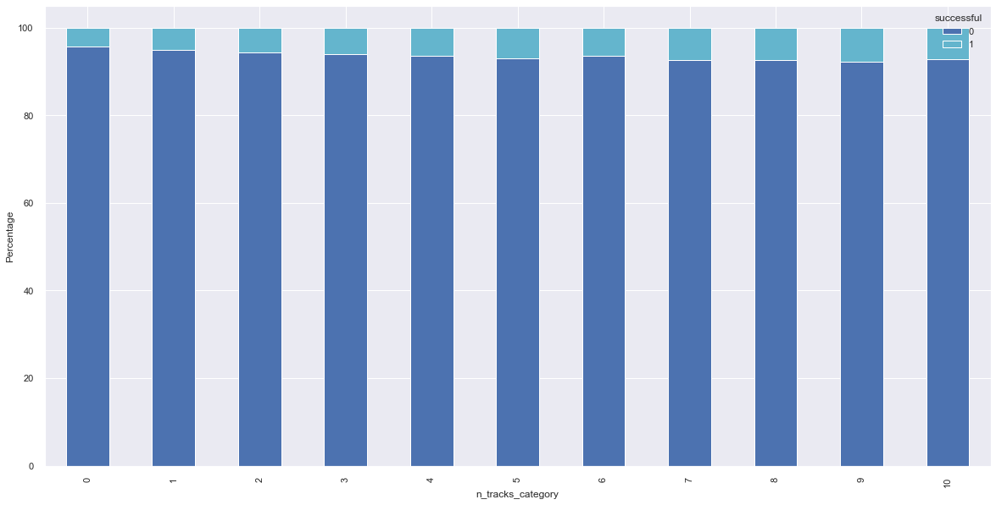
Number Of Tracks, Artists And Albums For Successful And Unsuccessful Playlists
n_artists
n_albums
n_tracks
As the number of tracks, albums and artists increase the percentage of successful playlists increase as well, in small numbers
Notes:
We can see that as the number of artists increase the number of successful playlists increase as well
The case is similar for number of albums and number of tracks too
We see that the increase is in small numbers
We can see a positive relationship on over all successful playlists as factors like num tracks, albums and artists increase.

Slide 16
Summary
There are a total of 403366 playlists and 19780 are successful for all the metrics, ~5% of the playlists.
Genres like Blues, Latin and Traditional are popular over successful playlists and genres like Alternative, Dance & House, Rap are popular over unsuccessful playlists.
Moods like Easy Going, Peaceful and Romantic are popular over successful playlists and moods like Defiant, Melancholy and Yearning are popular over unsuccessful playlists.
Having a greater number of tracks, albums, artists shows some positive impact over successful playlists.
Notes:
Here we summarize what we learnt from the previous graphs that there are about 19,780 successful playlists
Popular Genres and Moods
Greater number of tracks, albums , artists means more % of over all successful playlists.
This concludes Part A of the presentation.

Slide 17

Schema Design
z
Notes:
That is the start of Part B of the presentation on Schema, Scale and Automation.
Let’s look at schema part

Slide 18
Considerations and Assumptions:
How would you change the current schema, or design a new one, to make it more analysis friendly?
Stared with the lowest grain for playlist analysis, definition of dimensions and facts will help slice the data across multiple dimensions.
Understanding the structure of source data gives a clear picture on schema design.
Extended discussions are necessary with the consumer of schema on how data must be presented so that the user may not have to do additional transformations for further analysis.
The schema is created keeping presented data set in mind.
Some assumptions were made while designing the schema like: we have tables for songs, song plays, tracks, playlist, albums, user information etc.
Notes:
Started with the lowest grain, This helps us aggregate easily vs starting at an aggregated level will be difficult to go back
If there are any issues with the data we can come back and check at the source
We separate dimensions to facts, This is a easy way to slice the data across and get the required information
While doing so understanding the source data and how will the target data be consumed is extremely important as will help us in structuring our code/query in a way that we can aggregate at the right level and make sure all business level transformations are applied we produce a quality data set for consumers
State the assumptions listed

Slide 19
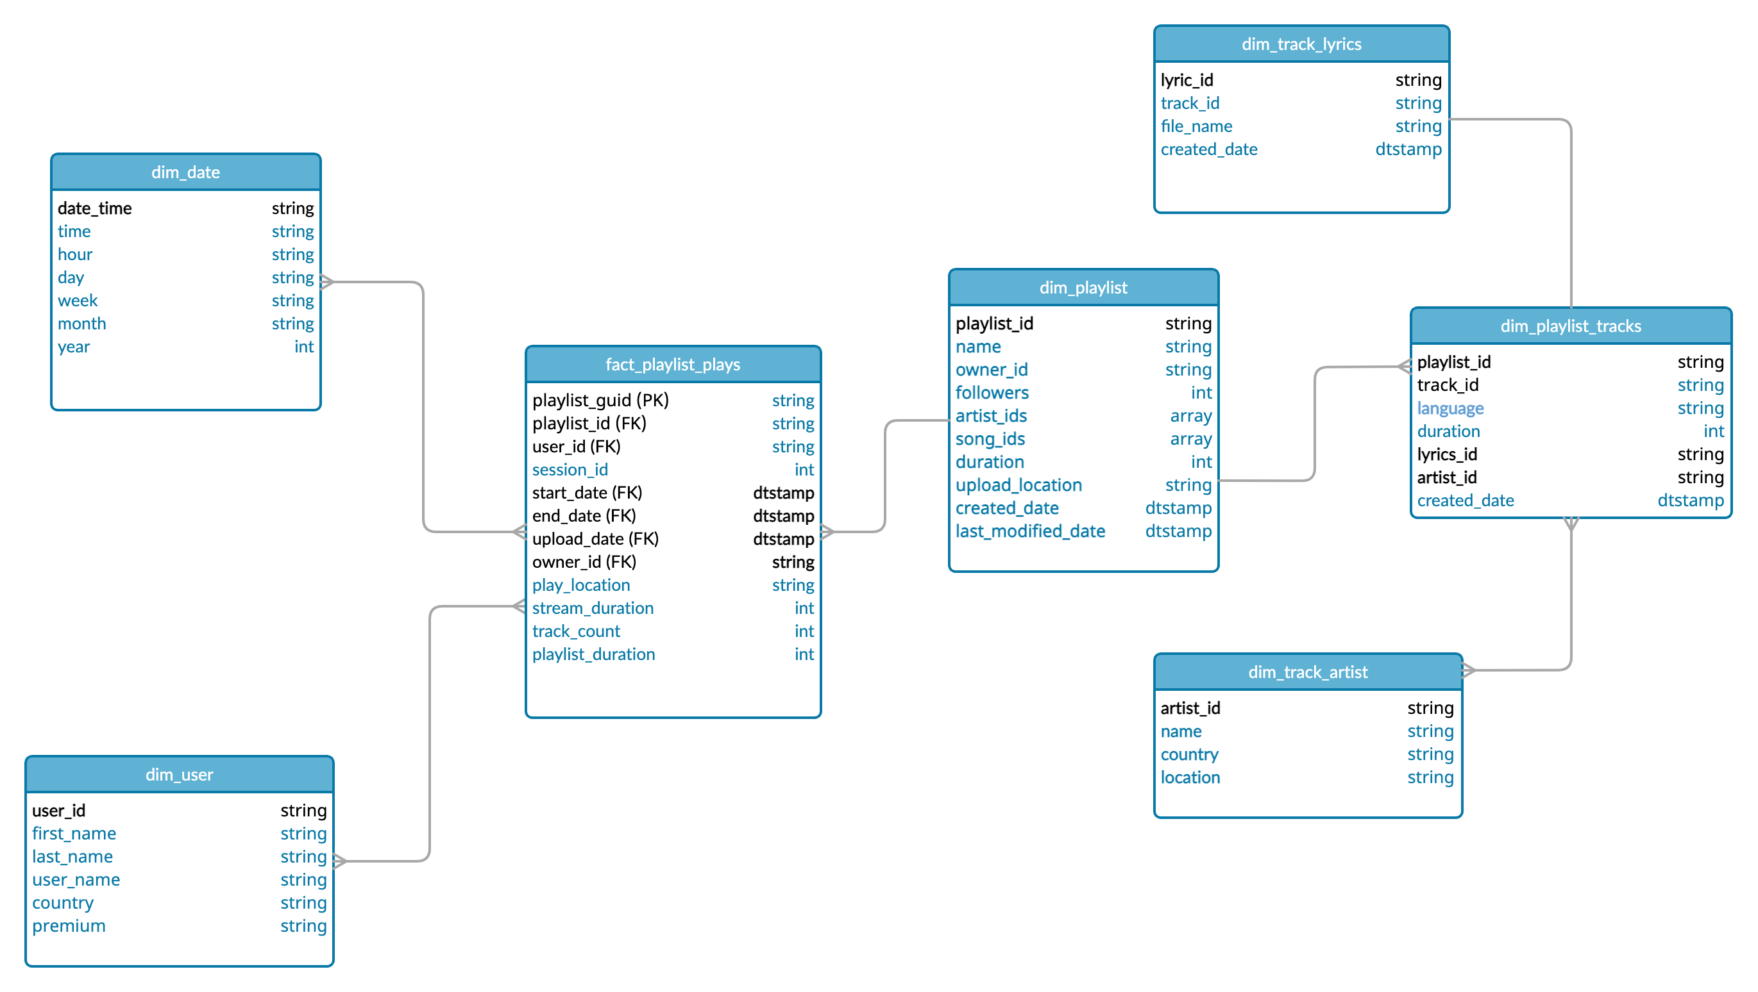
Schema Design
Notes:
This is a high-level relational design if we want to analyze playlist data
We have playlist plays where we can get the start time and end time etc.
A stand-alone playlist table that contains all important playlist information that ties to tracks, artists, lyrics etc.
We have a user dimension where we can obtain the user information of people who interacted with the playlist, additionally say the owner of the playlist is an user we can also join it to the user table to get additional owner information.
A key thing here is normalization at the right level, for this scenario rather than creating another dimension table for user we can just connect to one table for user and owner information Just from one join to a table.
Having a schema like this will help us, extract and aggregate the data we need and makes it analytics friendly.

Slide 20

Scaling Up
z
Notes:
Next is scaling up

Slide 21
If this data was scaled up 1000x, across multiple tables, how would you have differently designed your solution and why? What about if the data was scaled up 1000000x?
Schema design:
Keeping tables compact by not adding additional attributes to the dataset outside the scope of analytic function.
Right level of normalization, additional normalizing of data will result in complicated schema design and affects the performance.
Right key design-surrogate keys, clustered keys, hashed keys for performance, lookups, data partitioning.
Use column store databases/ file storages this will help of IO for reading and writing data.
Currently my solution uses the local compute power and storage, using distributed storage and computing for faster data processing, engines like Spark and column store types like Parquet will decrease the data processing time and faster refresh rate of data.
Notes:
Three key points to keep in mind when we are designing a process that is data intensive:
Reliability, Scalability and maintainability
When we are looking at scalability:
Having the Right schema design will help in having the the information we need and the ability to extract and transform data easily
Having the right designed schema on a scalable database , can handle large traffic as well, parallel querying
Keeping the right amount of information, not going extra lengths to normalize the data, and designing the right keys with high cardinality
Along with schema design using more powerful machines for compute power and using many distributed smaller machines will help us run the process run efficiently even if the data grows 10-fold.
Using dB's/file storage like parquet or big query will help in achieving high compression ratio’s and grouping of column types together for faster processing
Using Engines like Spark for data processing, Parquet for data storage and Airflow for orchestration would be ideal for a data intensive process.
There is no one umbrella solution for all systems that scale, for our situation by practicing these we can be a in a good spot.

Slide 22
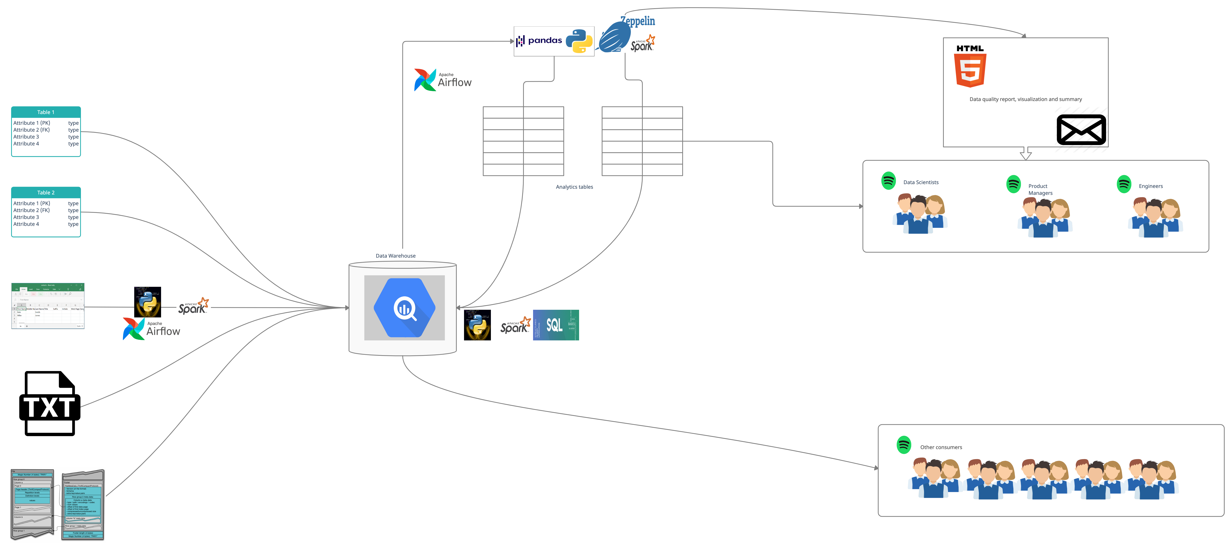
Source
Reports, Dashboards
Business level transformations
Raw Ingestion
Scaled Analytics Process
Notes:
Here is a high-level process we discussed
I want to add a point here, irrespective of the source our code should be able to handle extraction of data and enforce a standard schema and store It in a columnar database
We can use that as the source of truth for analytics purposes and build our analytical schemas from there
Essentially the diagram depicts that
We get information from various places and put it into our DW, we have our business level transformations and analytics table present in the same warehouse
We can create dashboards and summaries from these tables and present it to the users
Advantage of using column stores is, other consumers can use the same dw to access information for their needs, less latency, data partitioned the right way etc.

Slide 23

Automation
z
Notes:
Next up Automation

Slide 24
If you were asked to produce a version of your work which ran in an automated way, how would you do so?
Assuming the analysis must be done on a data set similar size and we are tracking the same metrics.
The code can be divided into its respective files of function e.g., extract.py, transform.py, summary.py, analysis.py etc.
It must be a configuration driven process, passing arguments like file paths for read and write, email address for notifications or data summaries etc.
A shell script can be used to pipeline the process by passing in necessary arguments.
Log any exceptions to a file e.g., logging module.
A high-level representation of the workflow can be found on next slide.

Slide 25
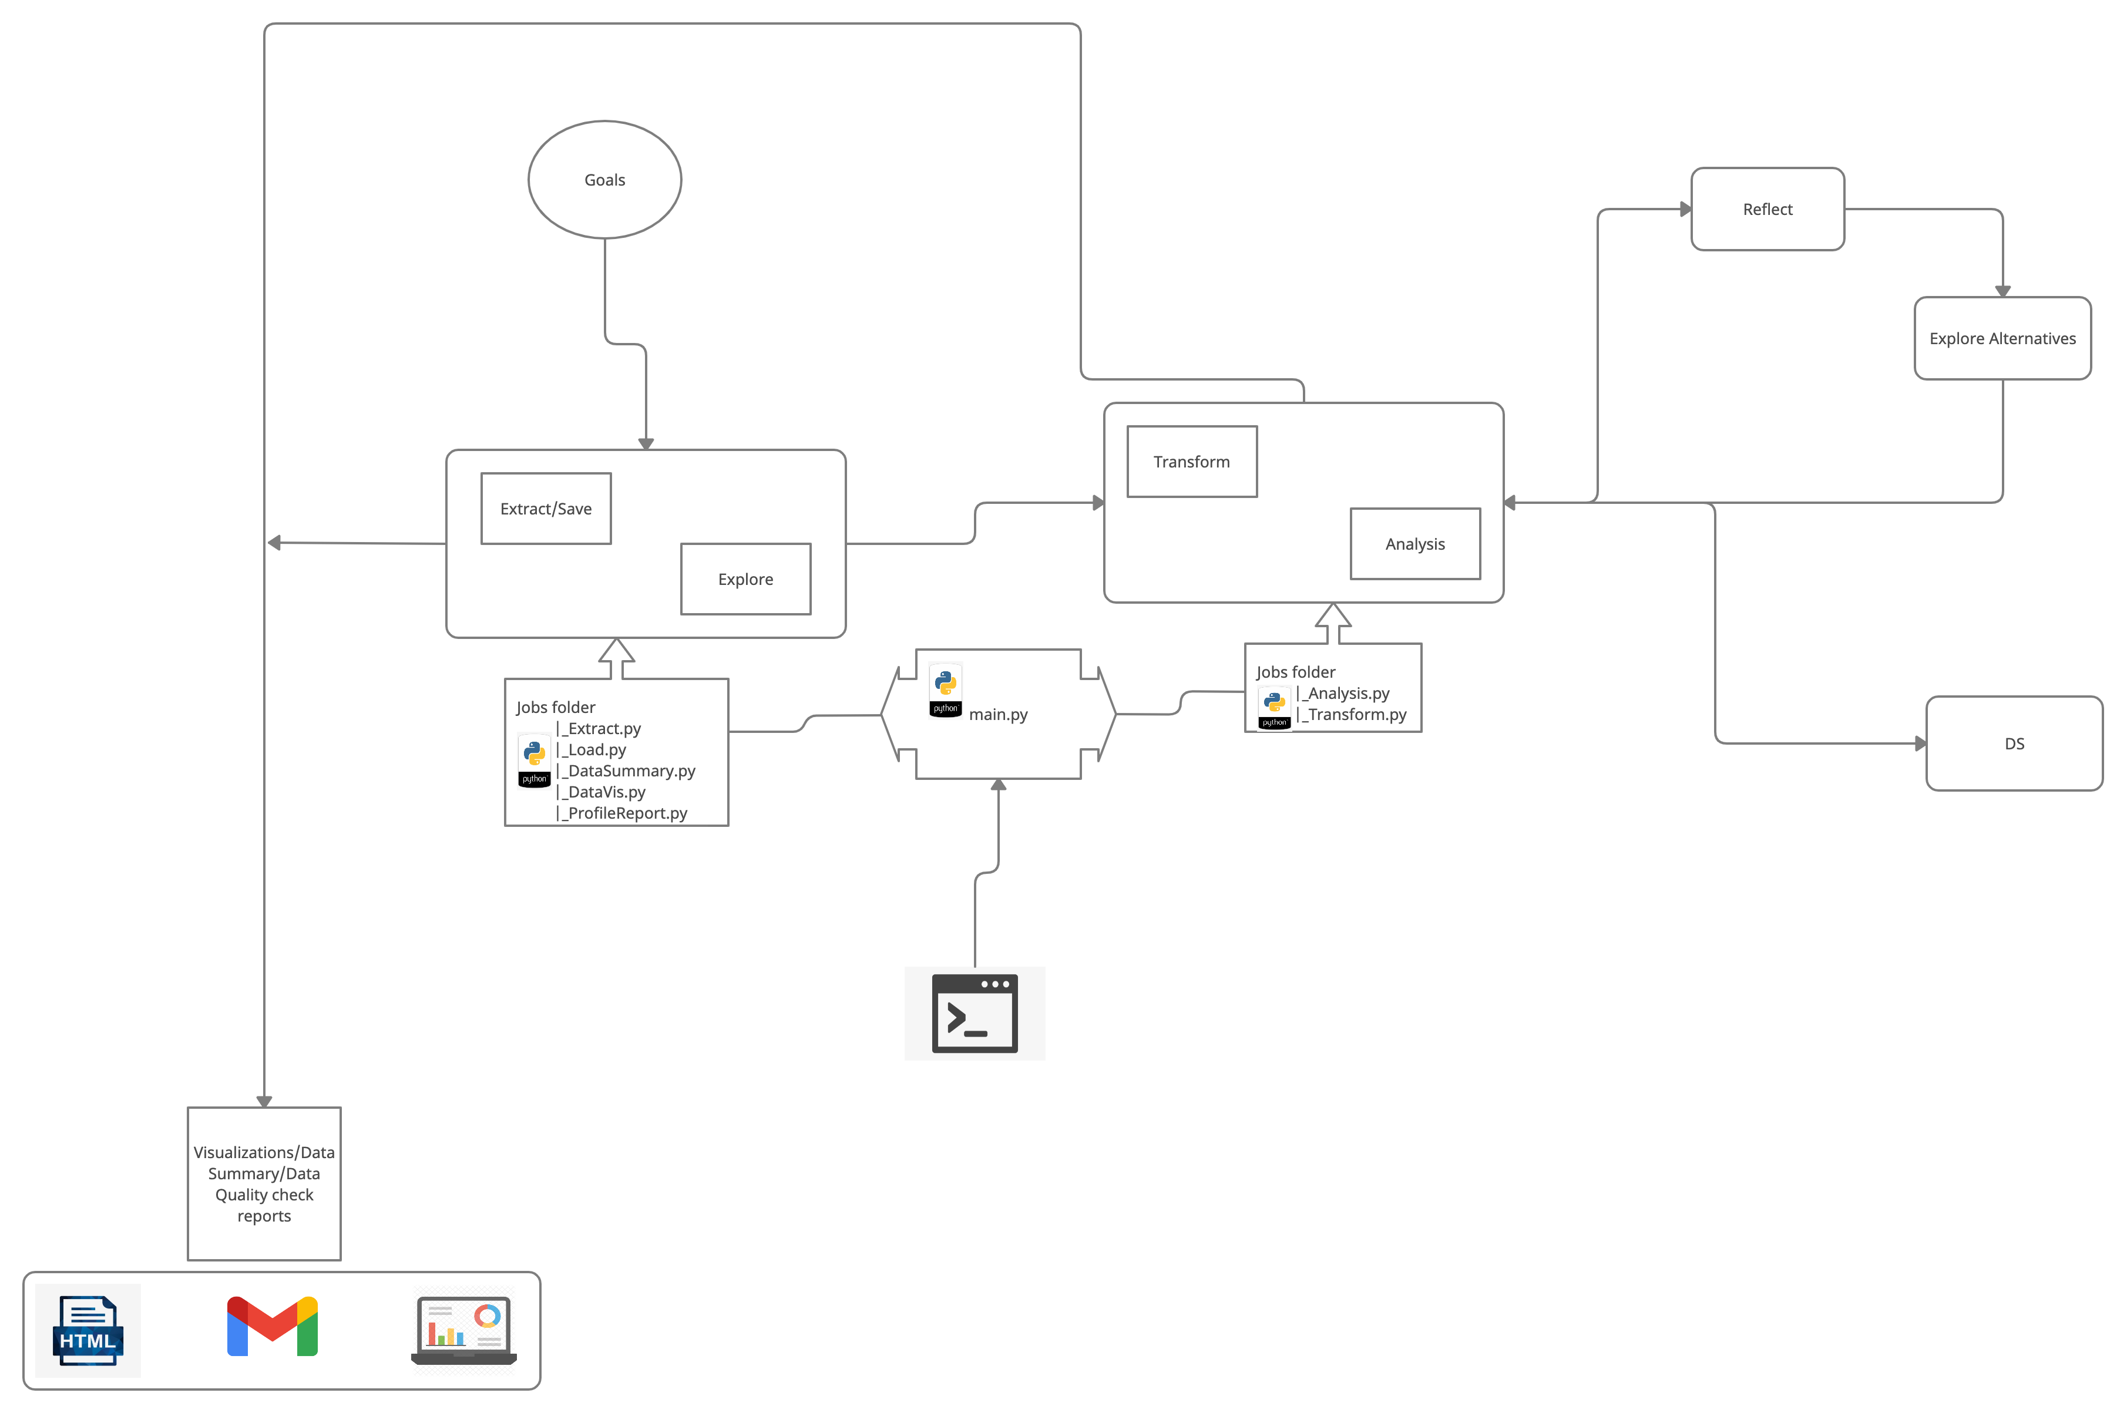
Workflow and Automation

Slide 26
Appendix

Slide 27
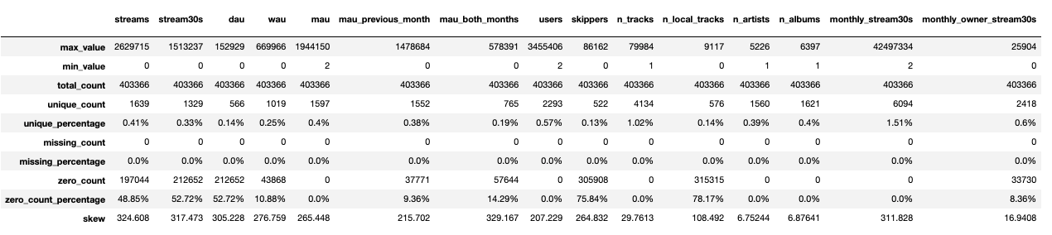
Summary Statistics: Numeric Variables
Variable names

Slide 28
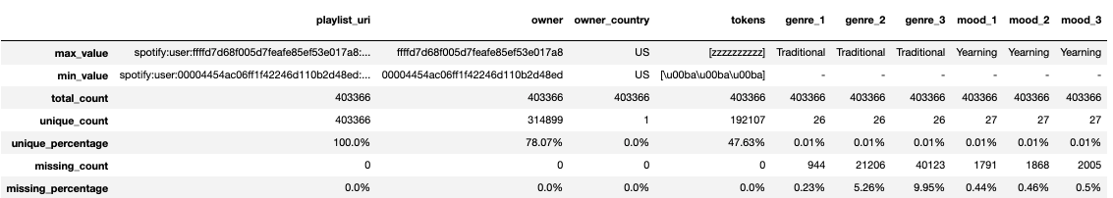
Summary Statistics: String Variables
Variable names

Slide 29
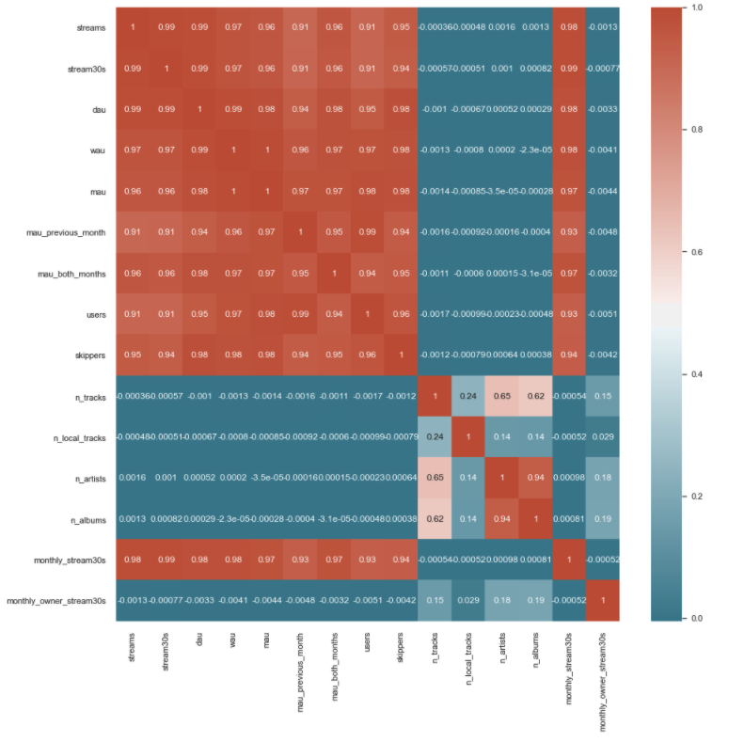
Summary Statistics: Correlation Matrix

Slide 30
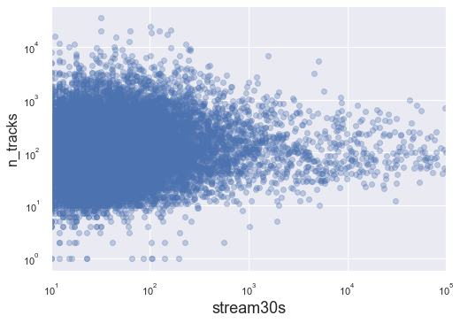
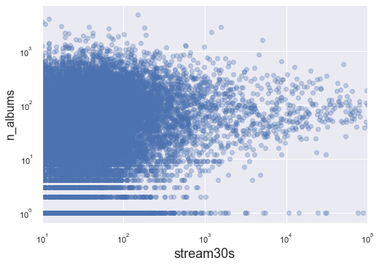
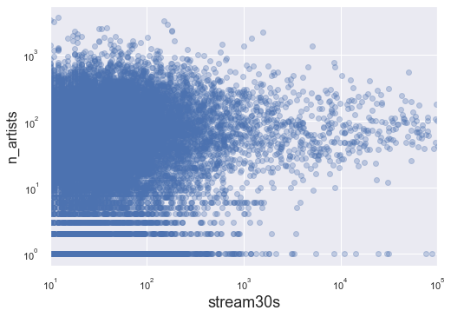
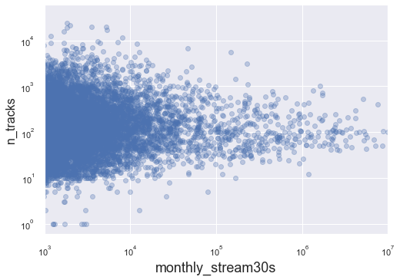
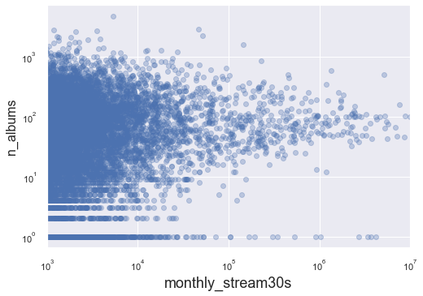
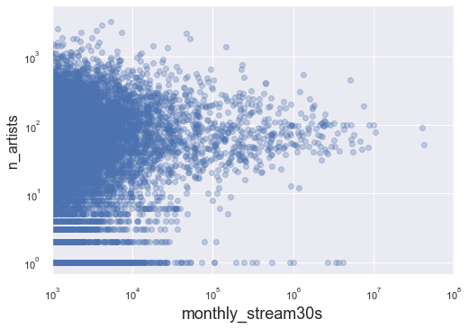
Measuring success metrics with numeric variables

Slide 31
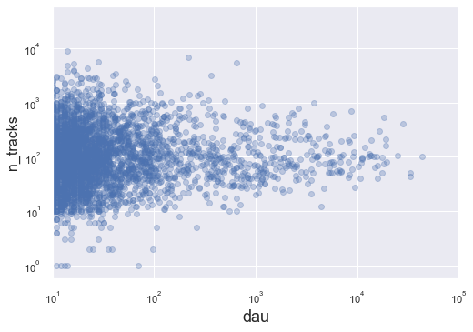
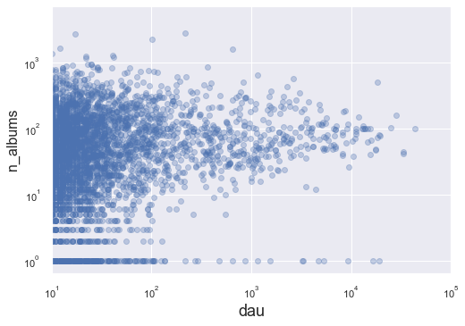
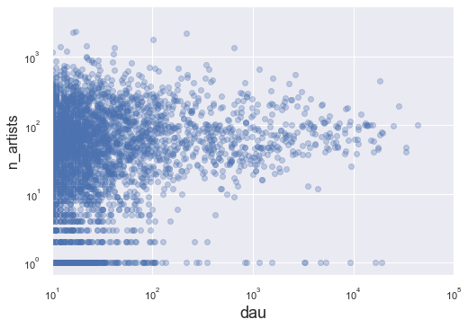
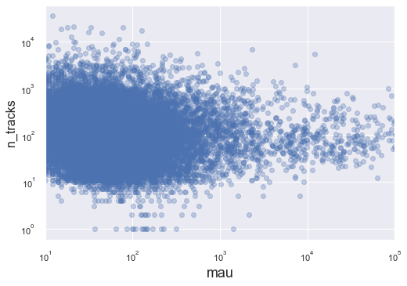
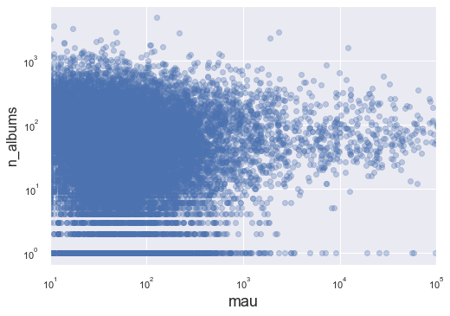
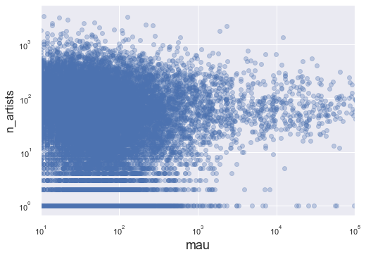
Measuring success metrics with numeric variables
z

Slide 32
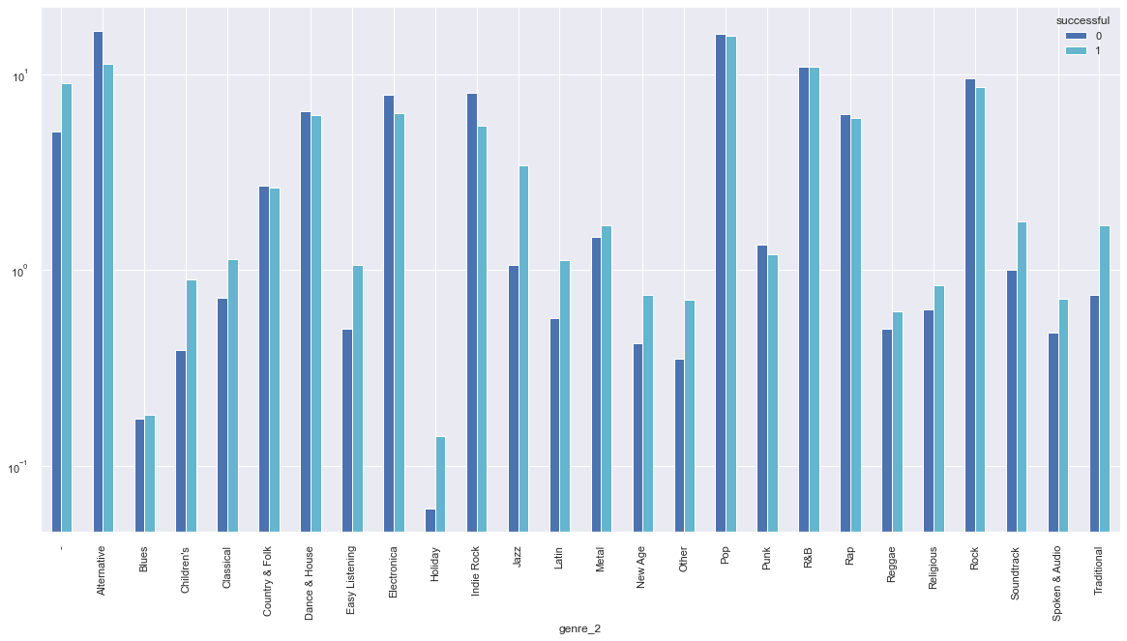
Genres For Successful And Unsuccessful Playlists
genre 2: second highest weighted genre

Slide 33
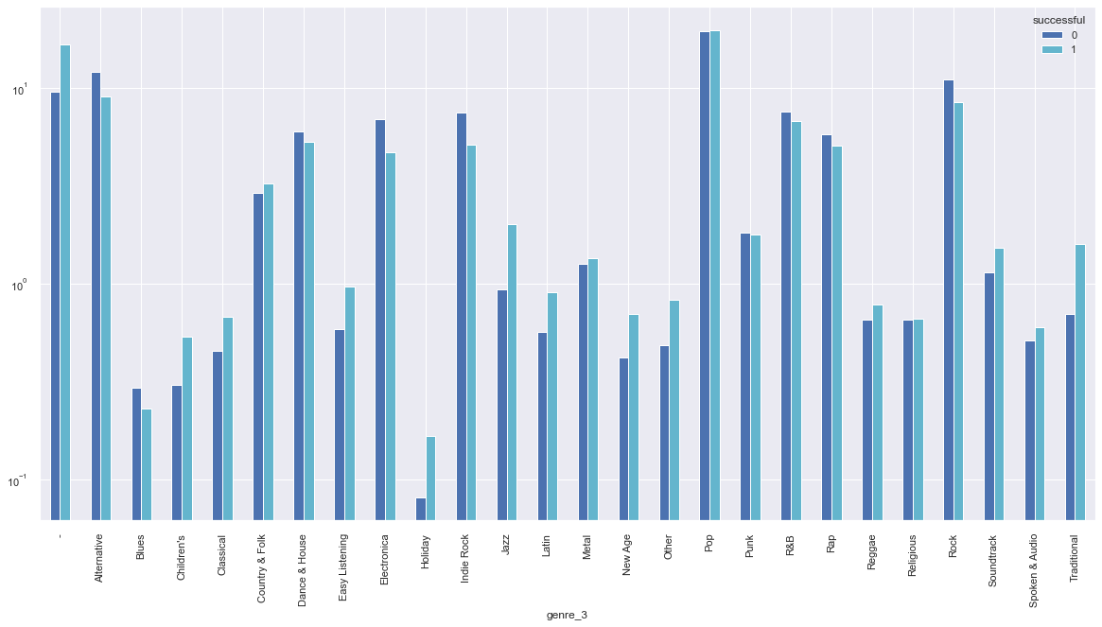
Genres For Successful And Unsuccessful Playlists
genre 3: third highest weighted genre

Slide 34
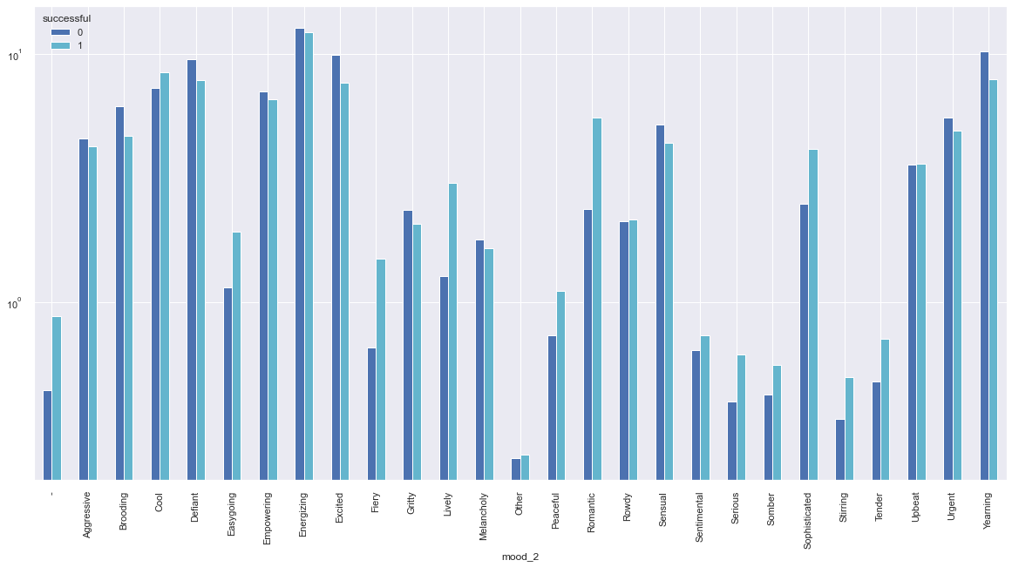
Moods For Successful And Unsuccessful Playlists
mood 2: second highest weighted mood

Slide 35
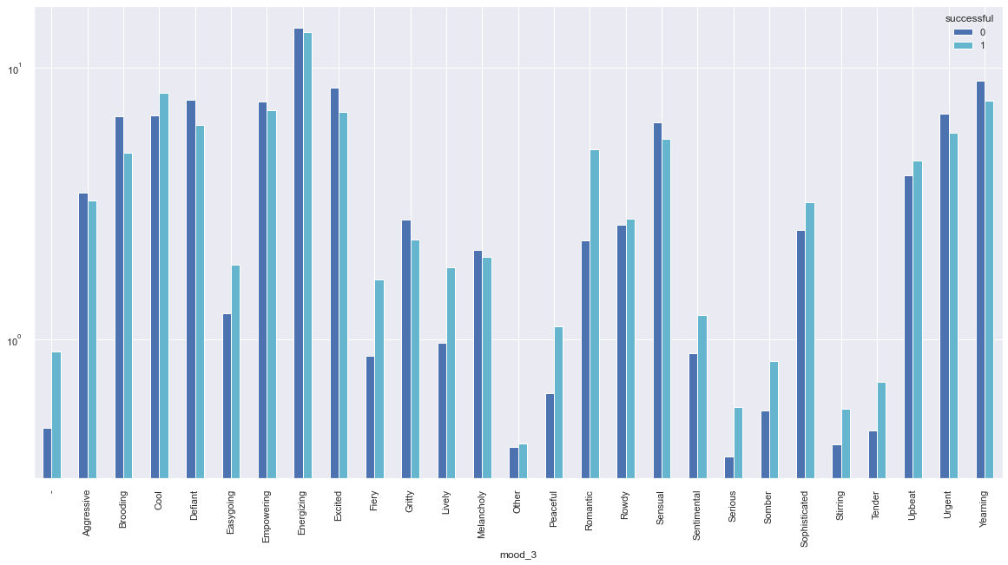
Moods For Successful And Unsuccessful Playlists
mood 3: third highest weighted mood

Slide 36
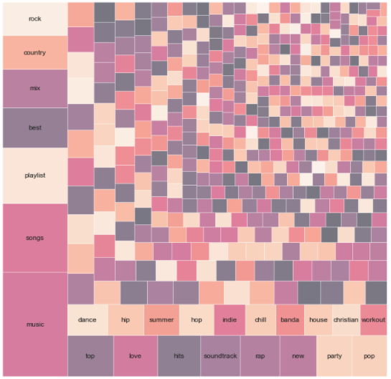
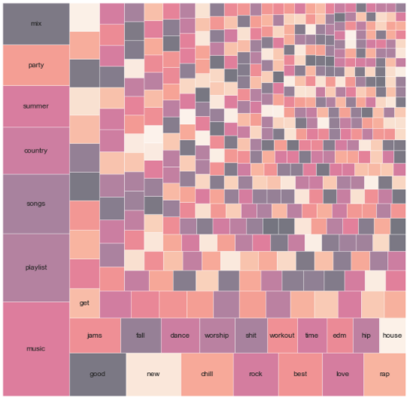
Playlist Tokens For Successful And Unsuccessful Playlists
Successful playlists
Unsuccessful playlists

Slide 37
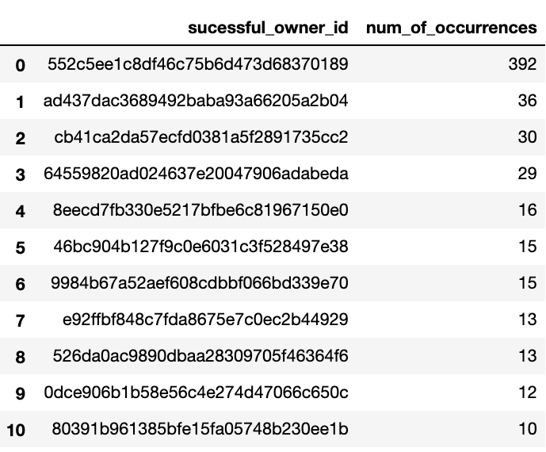
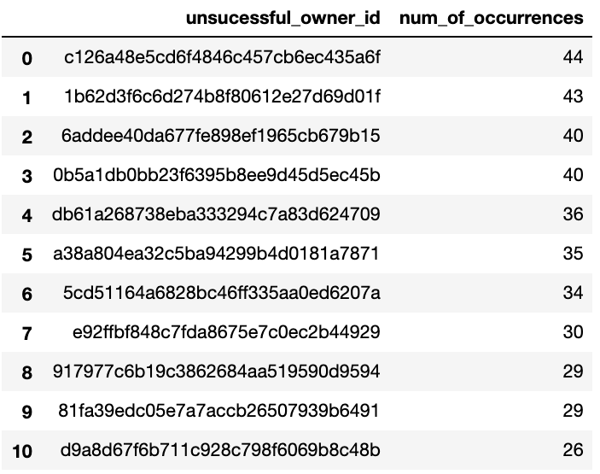
Playlist Owners For Successful And Unsuccessful Playlists

Slide 38
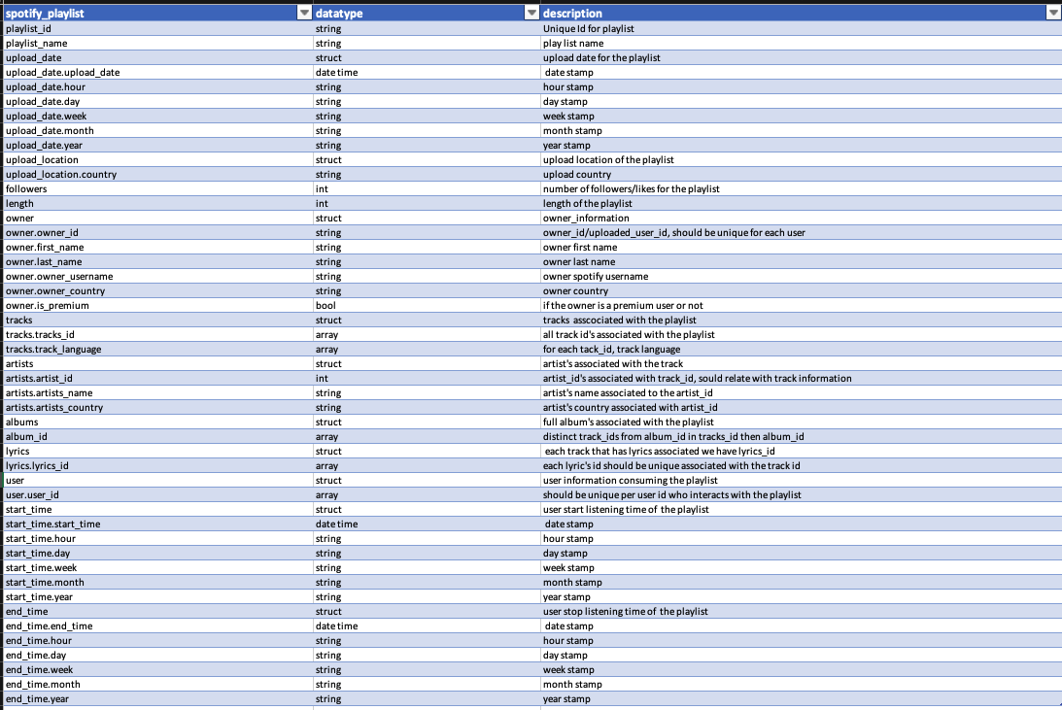
Schema Design: Nested Data Structures

Slide 39
Integrate lyrics data, which currently exists as 1 text file per track. How would you structure this dataset to allow data scientists to, in turn, flexibly perform analysis on how lyrics affect playlist performance?
23. Schema design : From this slide, the lyrics data has been integrated with tracks table.
Assuming we do not need the text from the lyrics file.
We create a unique id for each file and extract the file name.
Each file per track can be associated with its respective track_id.
We can aggregate this to the playlist level and create a new column as n_lyrics for each track_id that has an lyrics_id we can indicate True/False or 1/0 and count the number of True occurrences.
E.g., playlist_id: 1234 n_tracks: 10 n_lyrics: 5
n_lyrics can be used to check the influence on successful playlists.

Slide 40
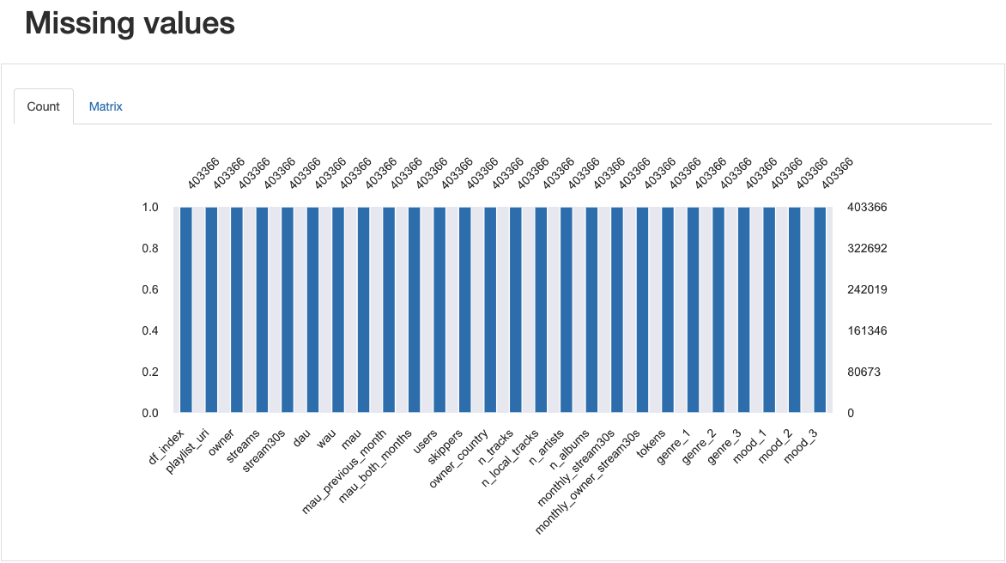
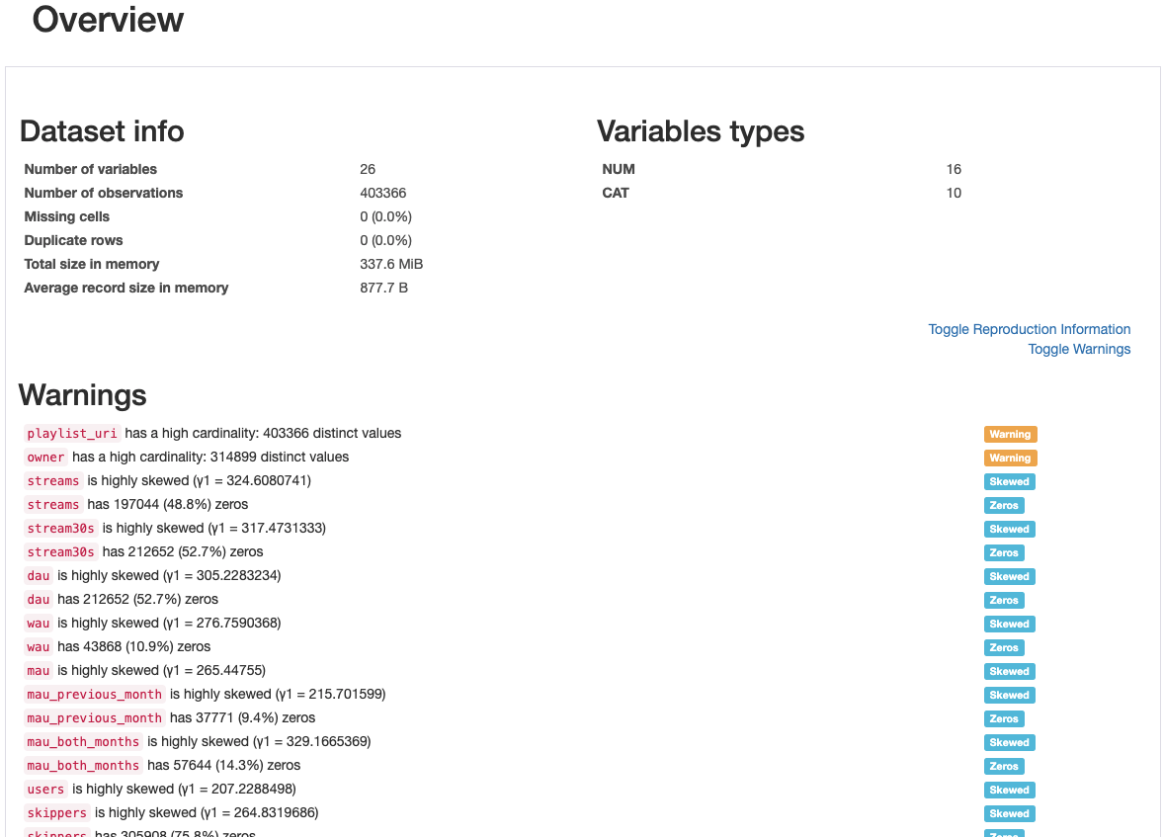
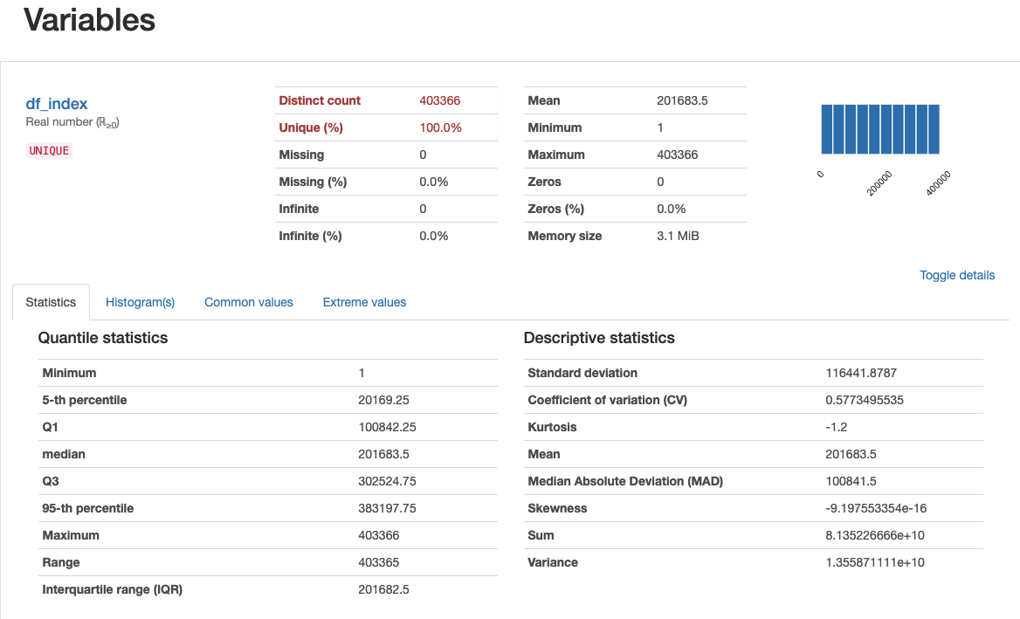
Data Profile Report
An Interactive version of the profile report has been emailed separately.

Slide 41
Summary
Day of the week the daily metrics are collected will help understand usage of playlists at a granular level.
Upload date can be used to check how old the playlist is and if there has been any activity on the playlist in recent time.
Information like playlist created by Spotify vs users will help understanding the the group creating successful playlists and further analysis can be done to learn what factors are contributing to the success of playlists created by a particular group.
Knowing number of likes the playlist can be added to the success metrics.
Data from different countries will help understand usage and engagement with playlists, further analysis can be performed on how variables like local tracks and local artists are impacting to the success of playlists.
Understanding where the playlists are placed in the product can also play a role. E.g.: is the playlist suggested on the home screen or if the user must search for the playlist.

